Slide 1

Project Title: Online Movie Ticket Booking System
FSD PROJECT REVIEW
Presented To:
CAPGEMINI
Team 2:
Karthik Raj S
Vigneshe B
Hariharan Dhanapathy

Slide 2
Problem Statement
The traditional way of going to cinemas can be difficult for customers as customers need to know the availability of seats, show timings, and movie options, especially when there are multiple cinemas in a location.
The present solution for a online booking system is not sufficient as there needs to be certain more implementations like having age restrictions to watch an A rated movie, and loyalty programs.

Slide 3
Objectives
The previous slide which deals with the problem statement gives way to these objectives which are kept in mind while designing the website:
Implement a fully functioning online movie ticket booking system.
Implement a responsive high level customer or user interaction with seamless access to their ticket information.
Implement a loyalty program for returning users.
Implement age restrictions on people going to a movie with A rating.

Slide 4
Features
Convenience: Online movie ticket booking provides a convenient way for people to buy movie tickets from the comfort of their own homes or on the go, without having to wait in long queues at the box office.
Time-saving: Online ticket booking saves time as customers can book their tickets in advance and avoid the last-minute rush.
Availability: Online movie ticket booking ensures that customers have access to all available seats in the theater, giving them the freedom to choose the best seats as per their preference.

Slide 5
Future Implementations
Future Implementations:
Payment Interface would be added for booking each movie ticket.

Slide 6




Technology Stack
Frontend | Reactjs
Backend | Spring Boot
Database | MySQL
ORM | JPA(Hibernate)
Testing | Junit and Mockito
Code Coverage | Eclemma

Slide 7
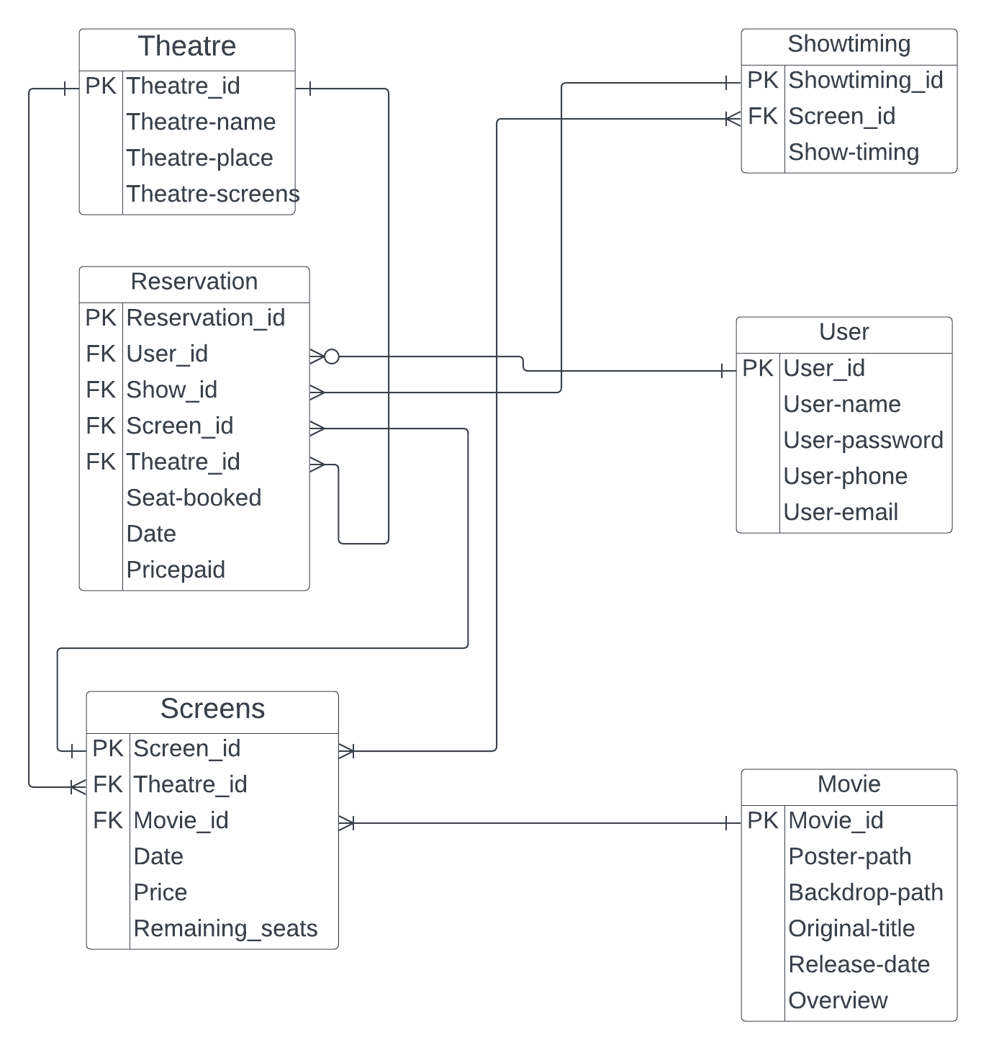
Entity-Relationship Diagram

Slide 8
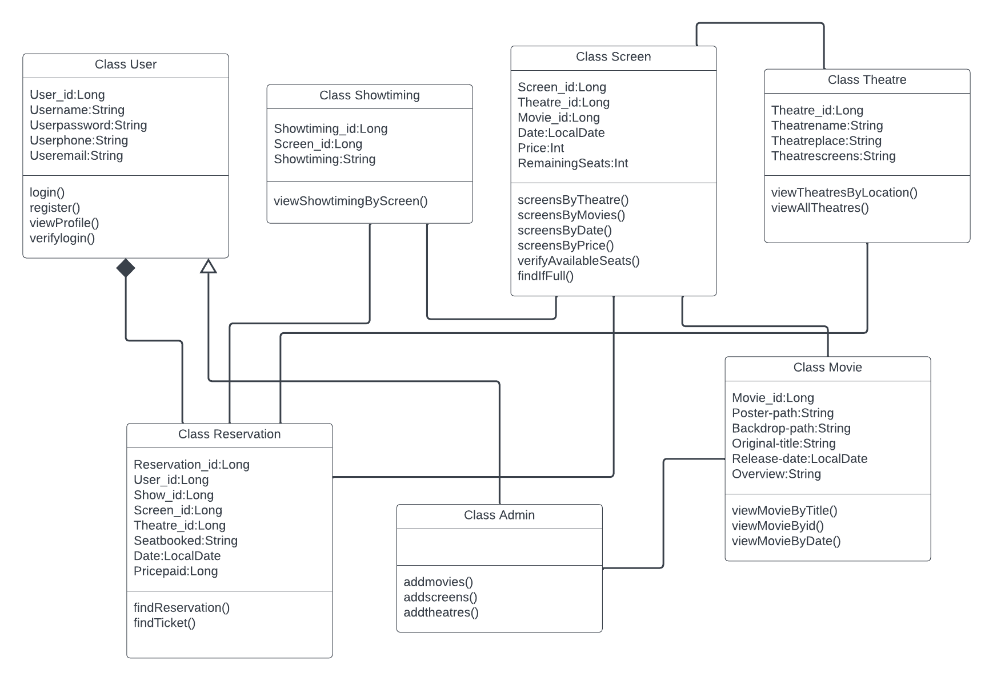
Class Diagram

Slide 9
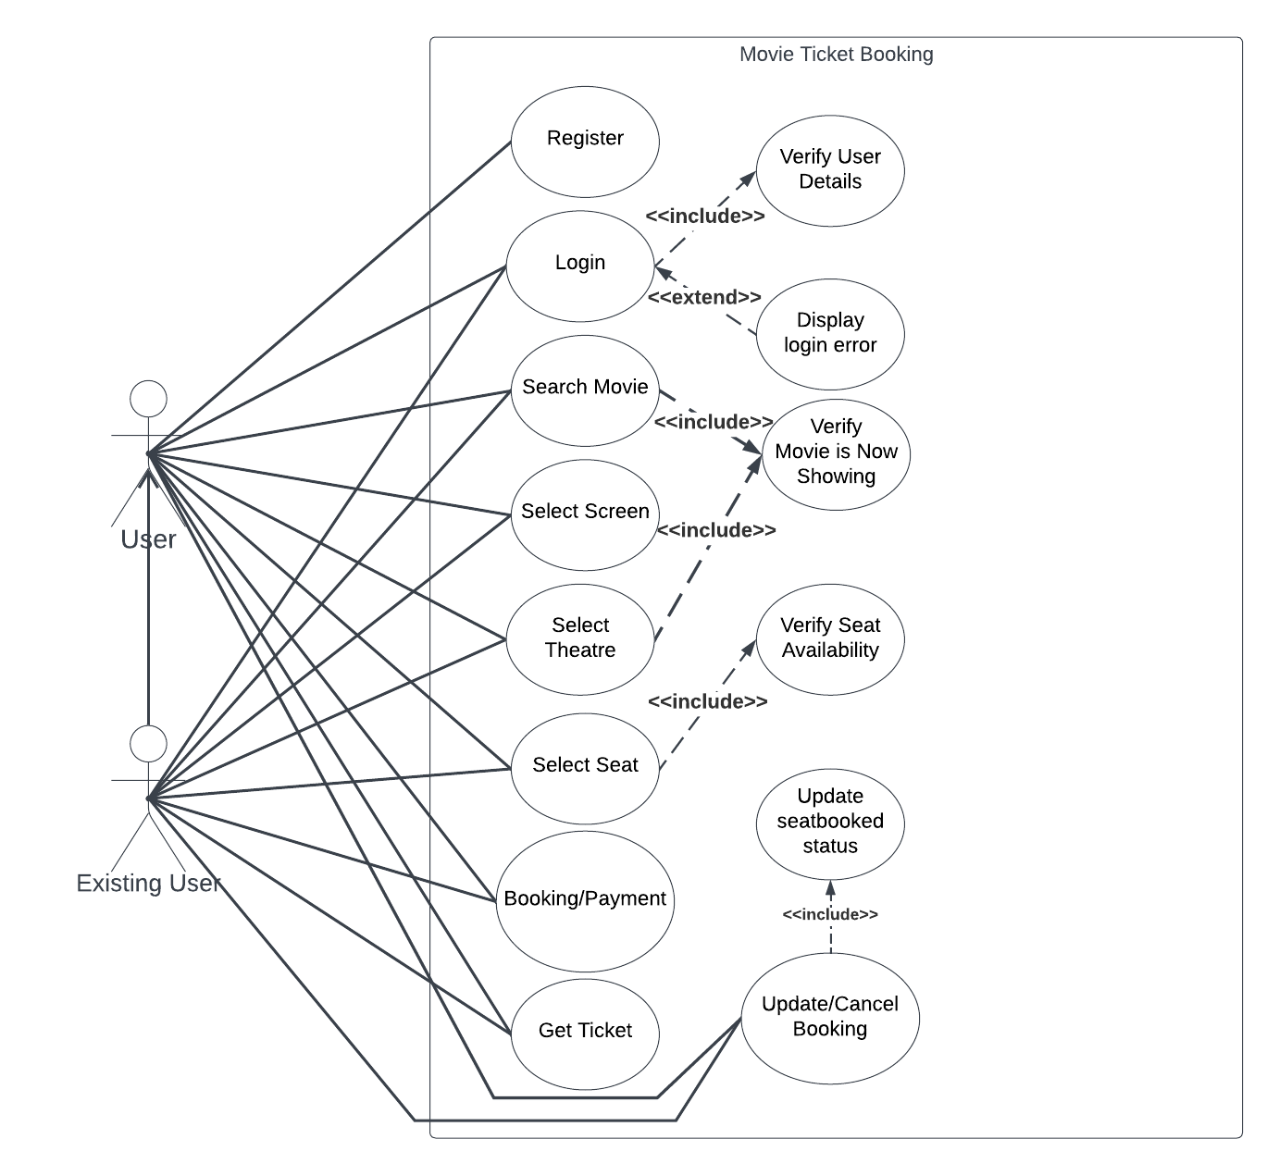
Use-Case Diagram

Slide 10
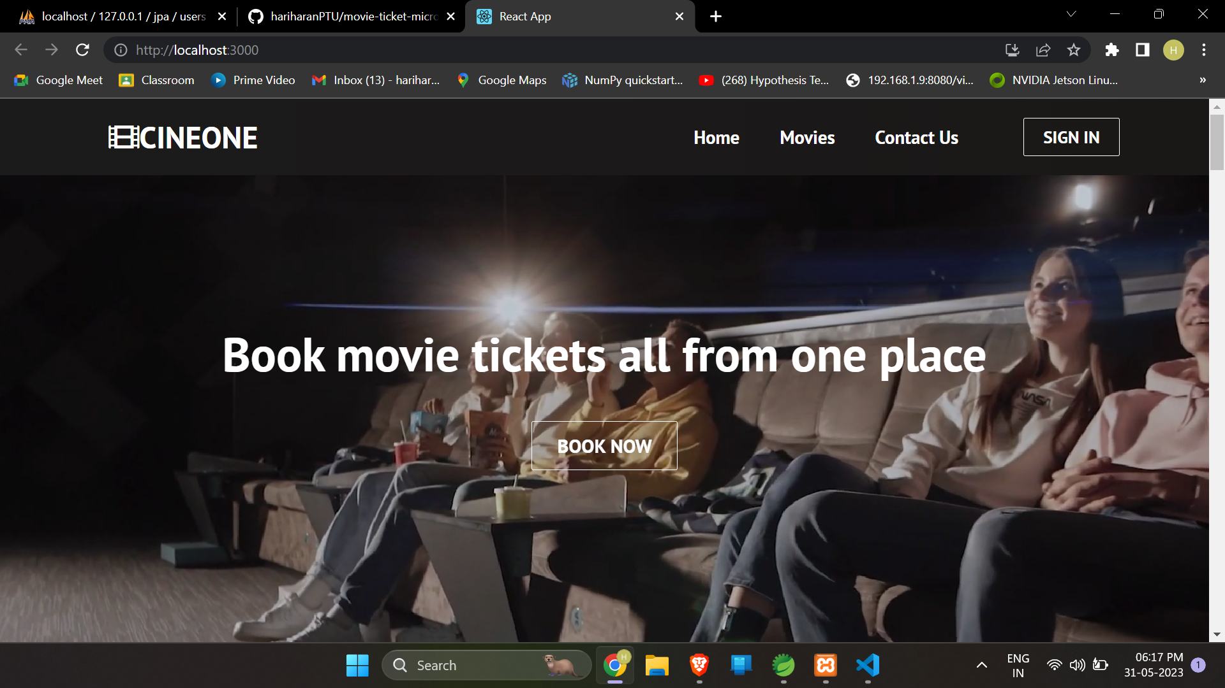
Website Pictures

Slide 11
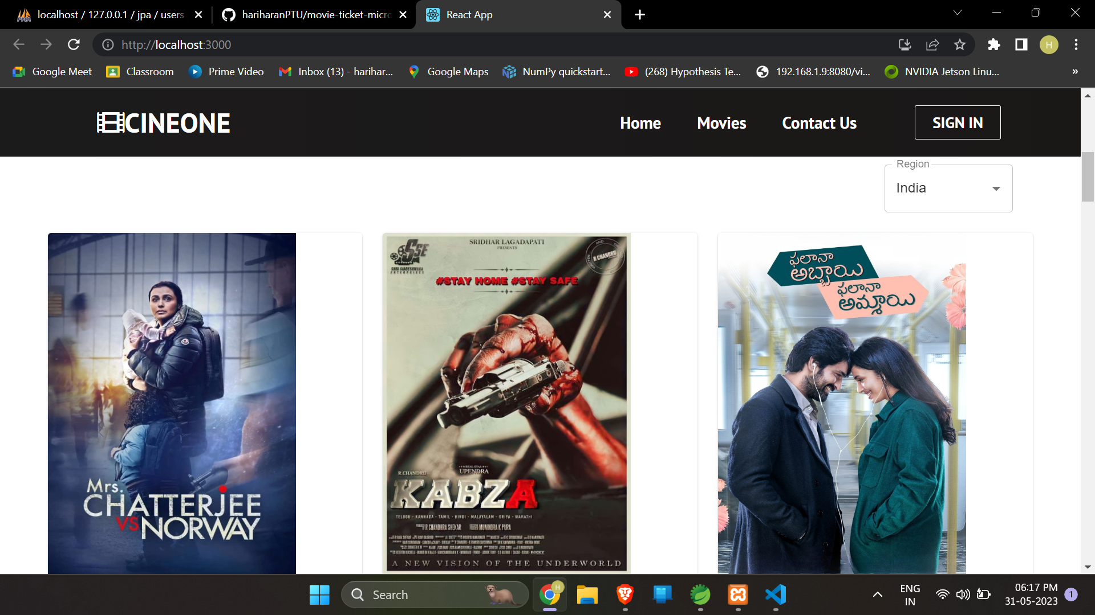
Website Pictures

Slide 12
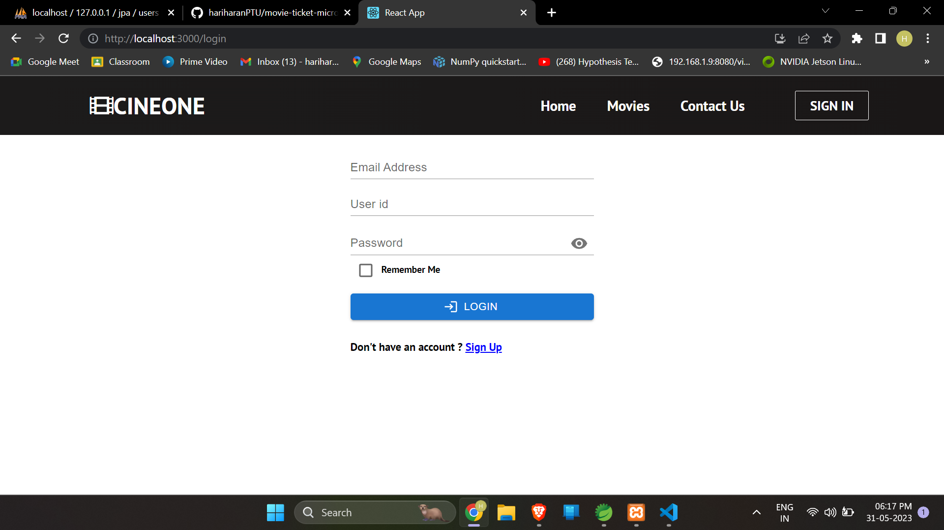
Website Pictures

Slide 13
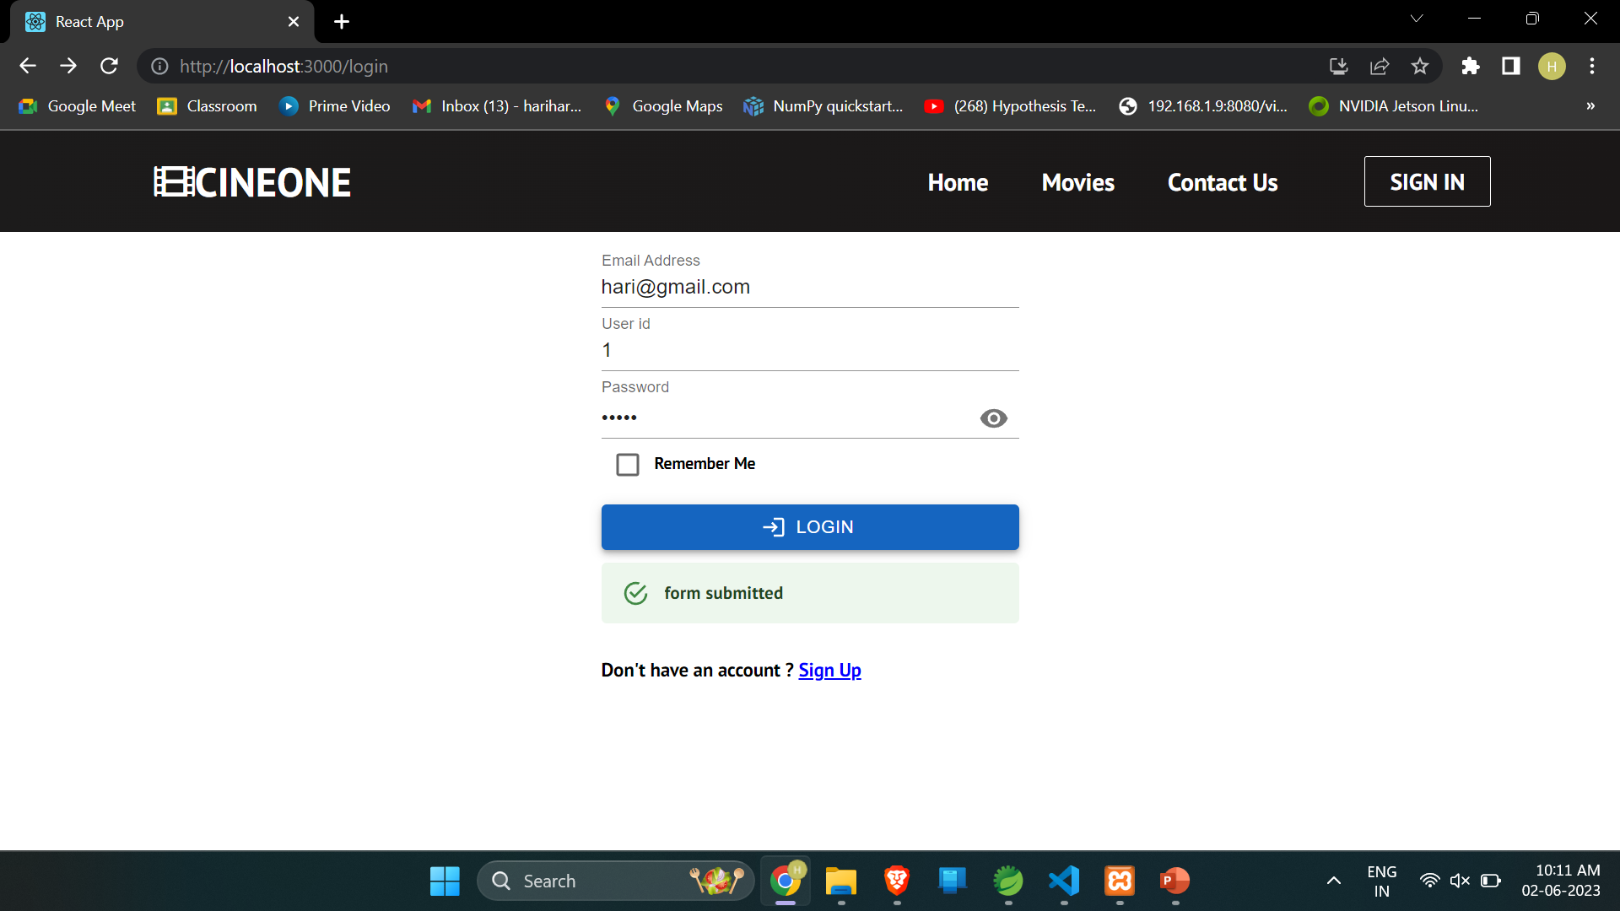
Website Pictures (Login)

Slide 14
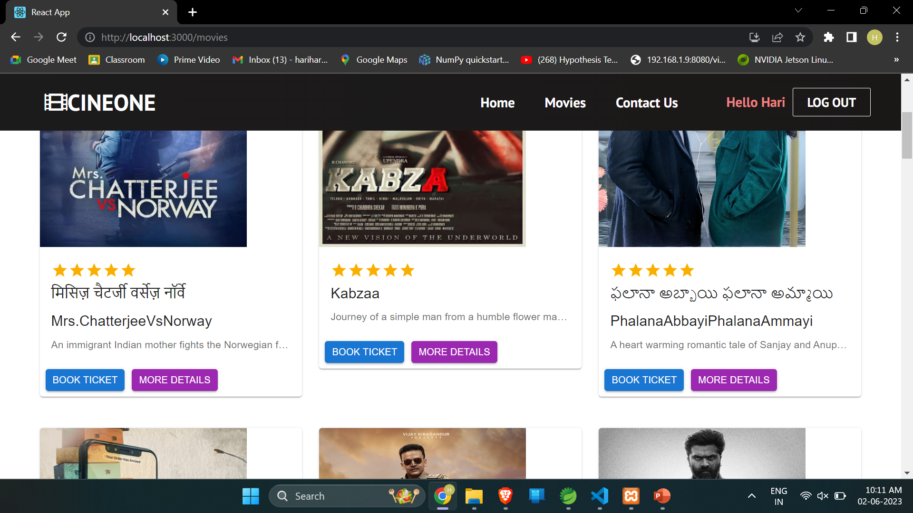
Website Pictures (Movies)

Slide 15
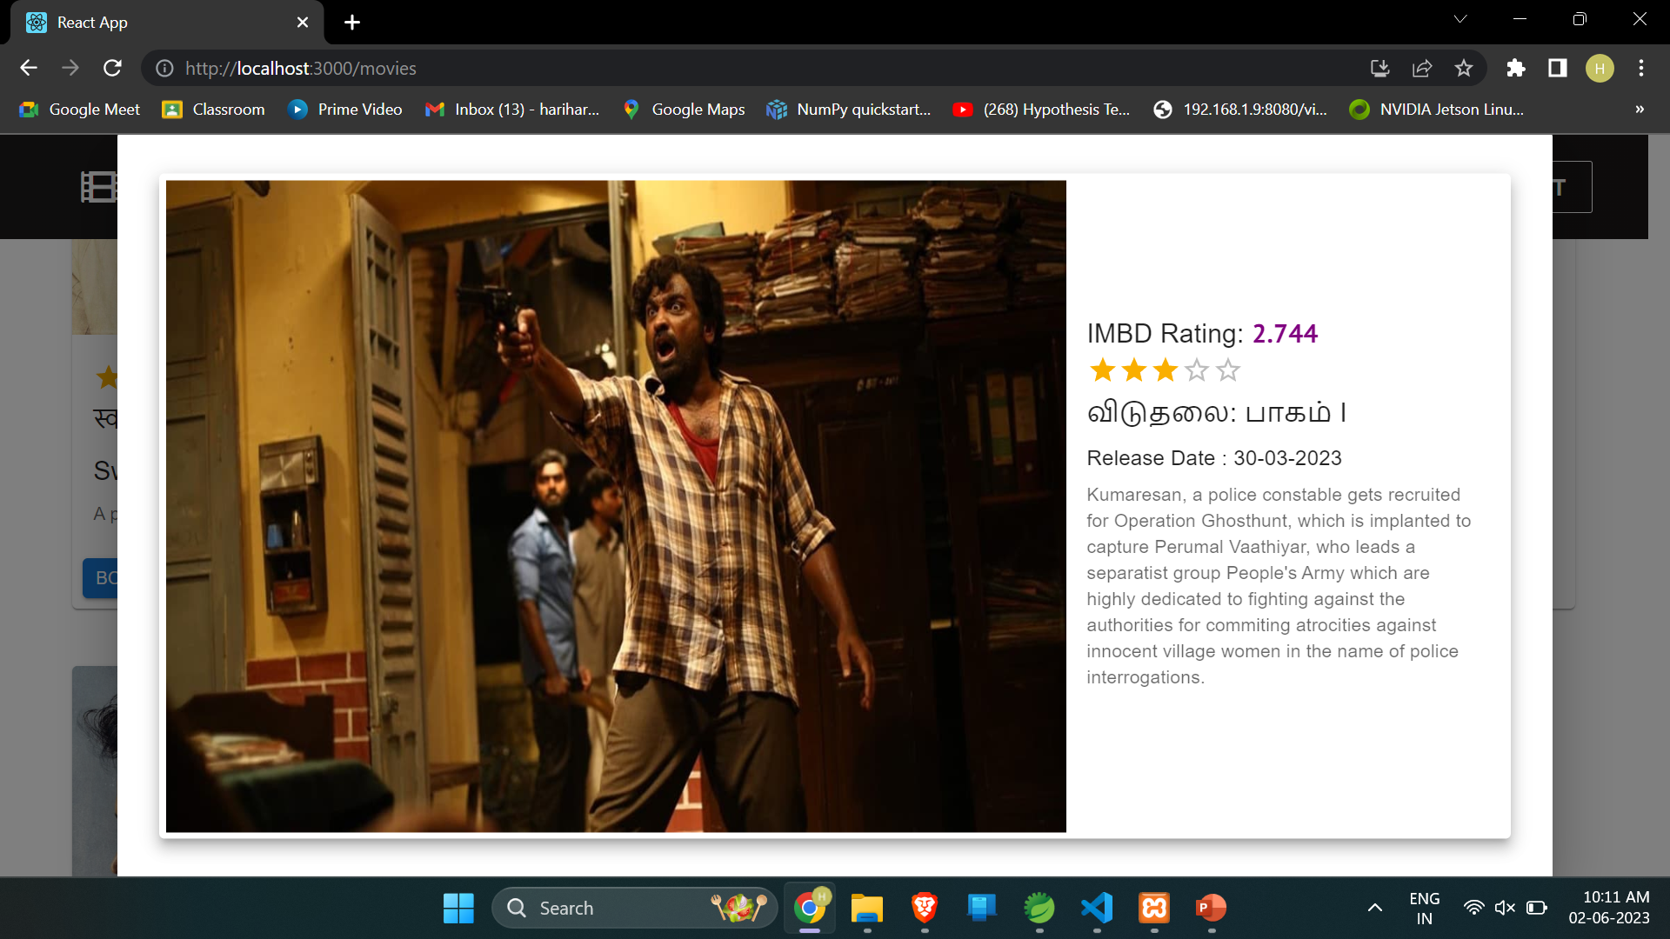
Website Pictures (Movie More Details)

Slide 16
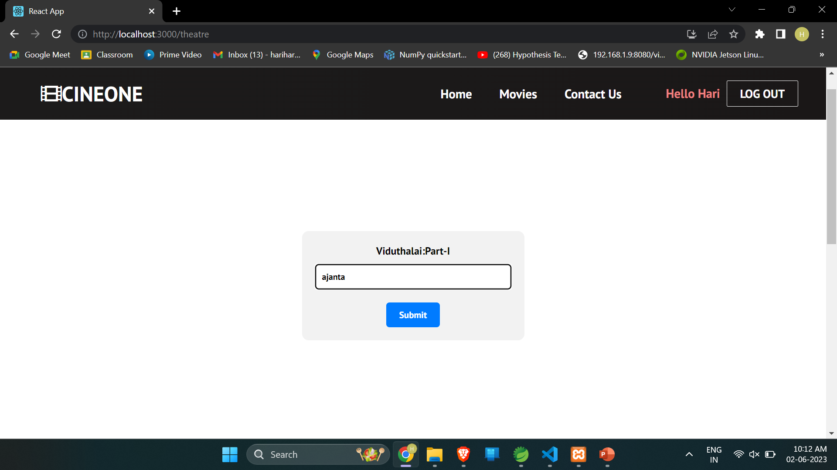
Website Pictures (Select Theatre)

Slide 17
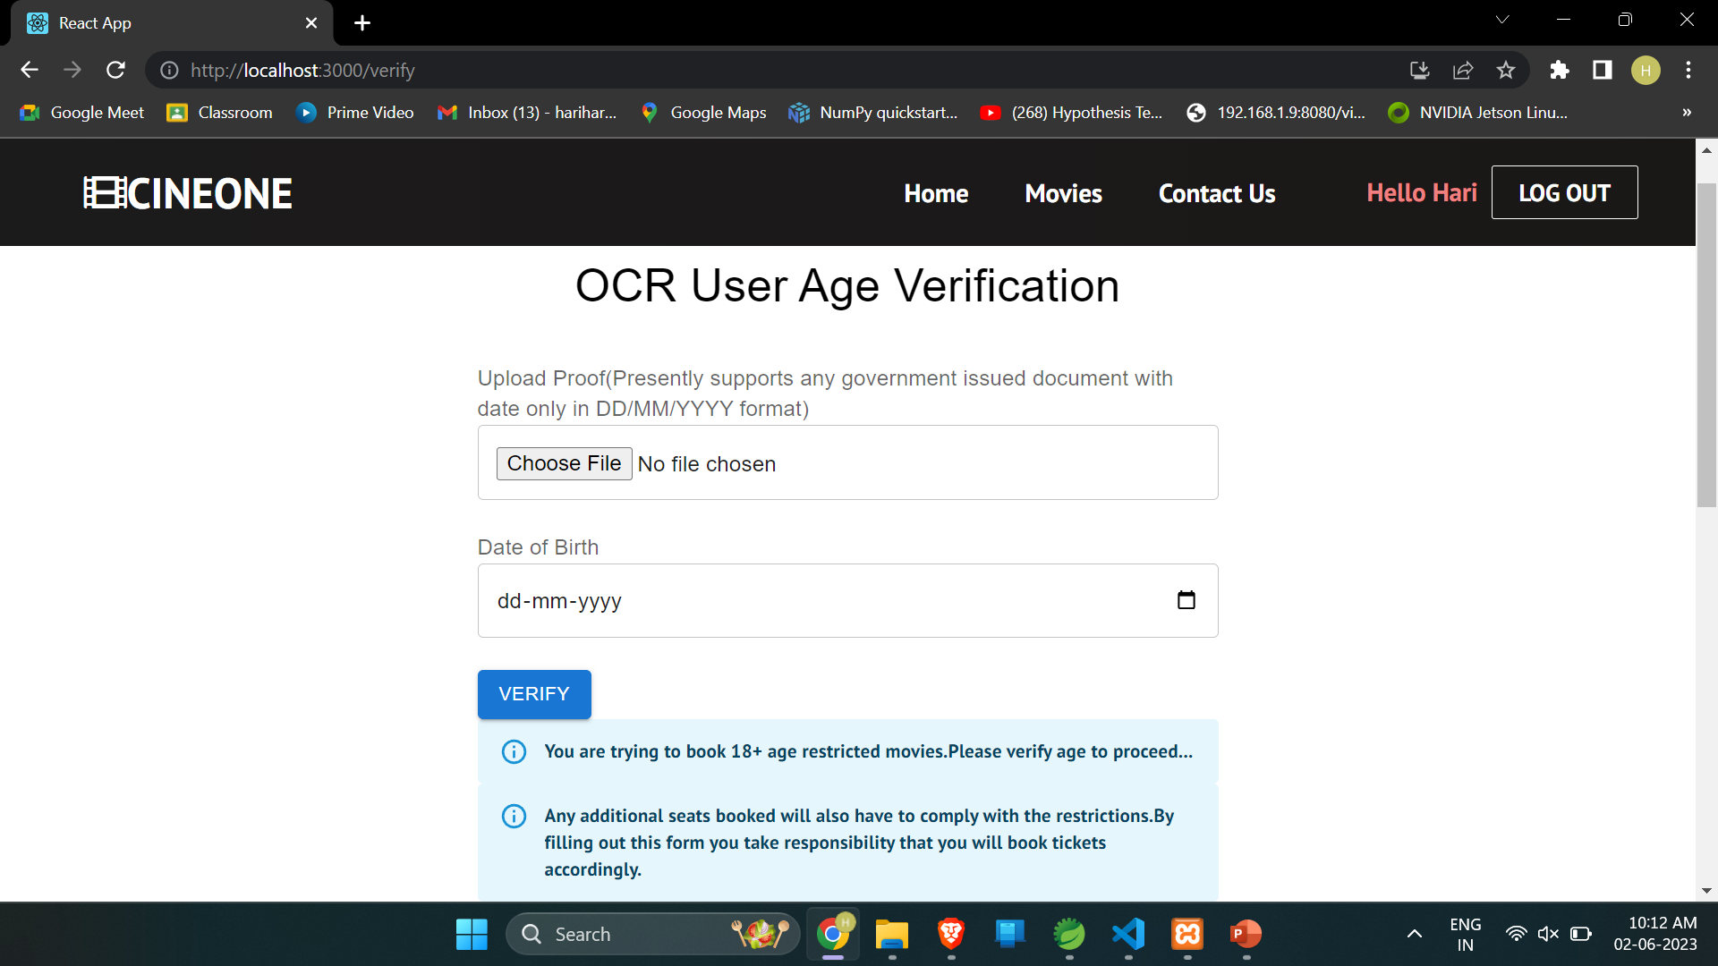
Website Pictures (Age Verification for A Movies)

Slide 18
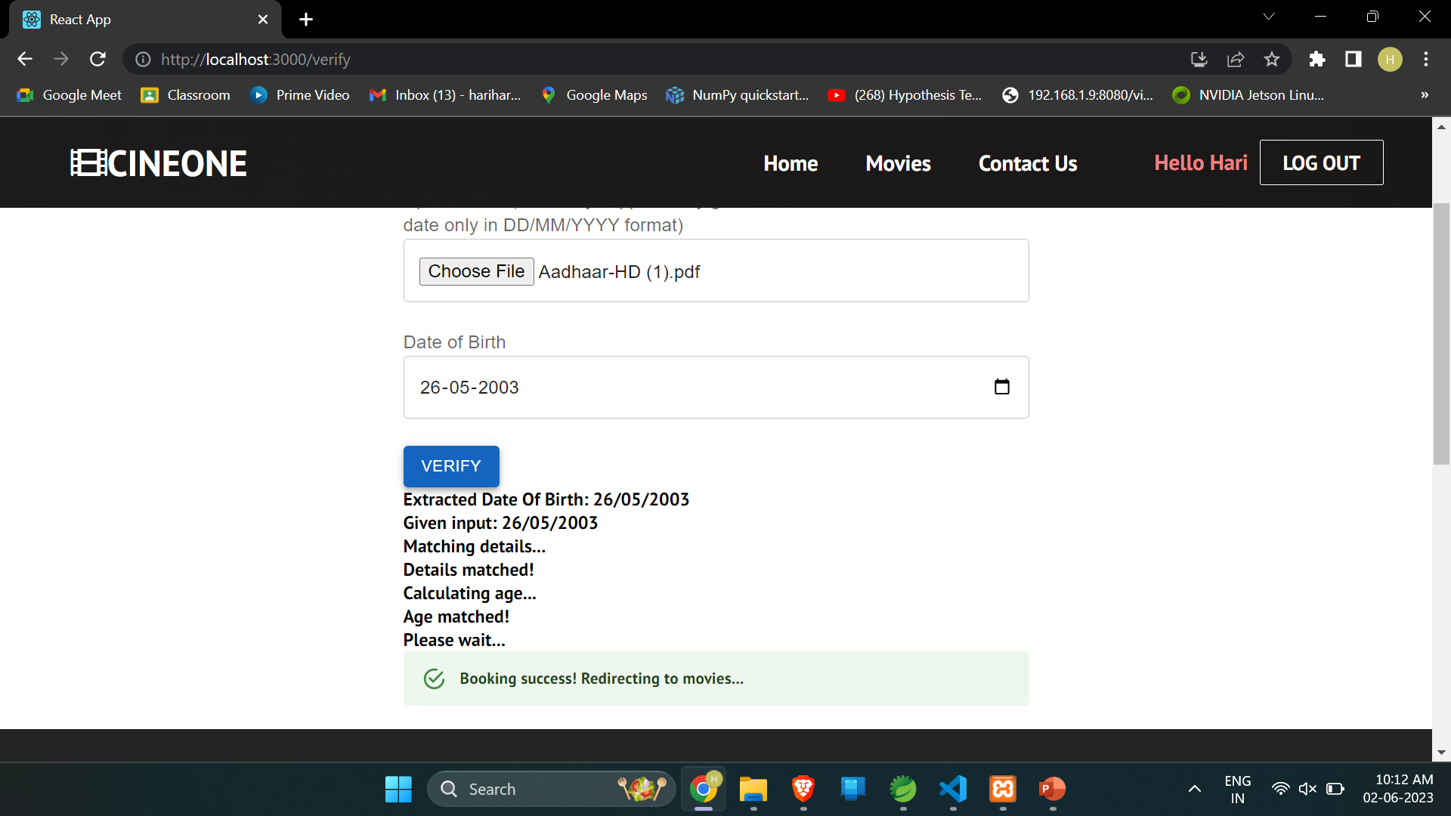
Website Pictures (Calculates age with extracted Date of Birth)

Slide 19
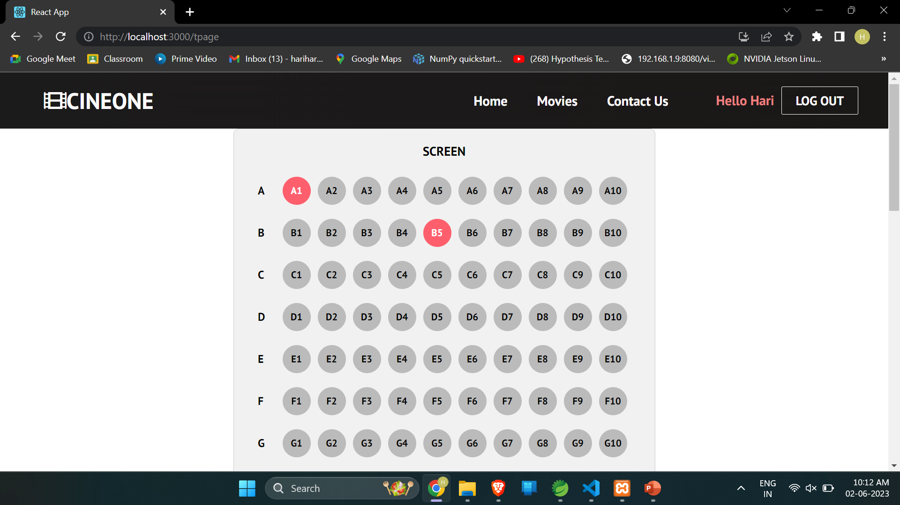
Website Pictures (Seat Details)

Slide 20
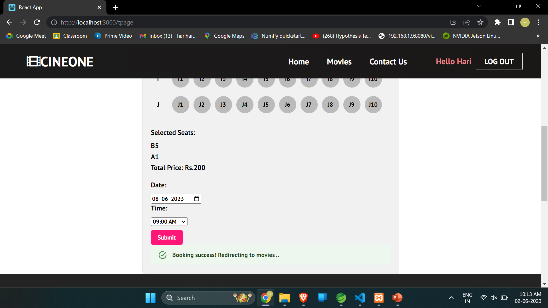
Website Pictures (Seat Details)

Slide 21
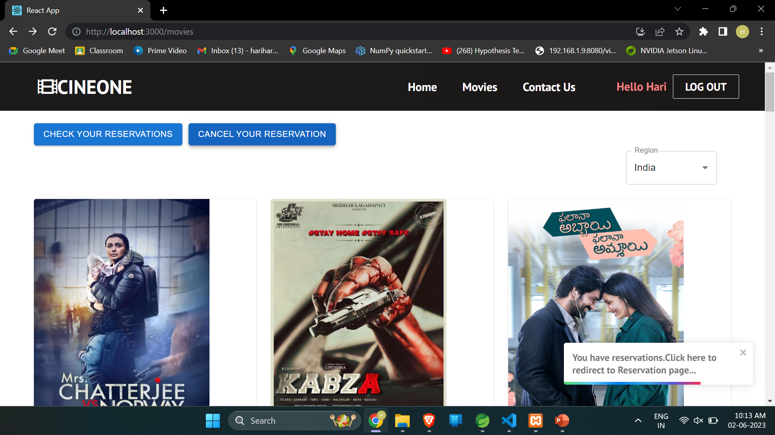
Website Pictures (Home page after reservation)

Slide 22
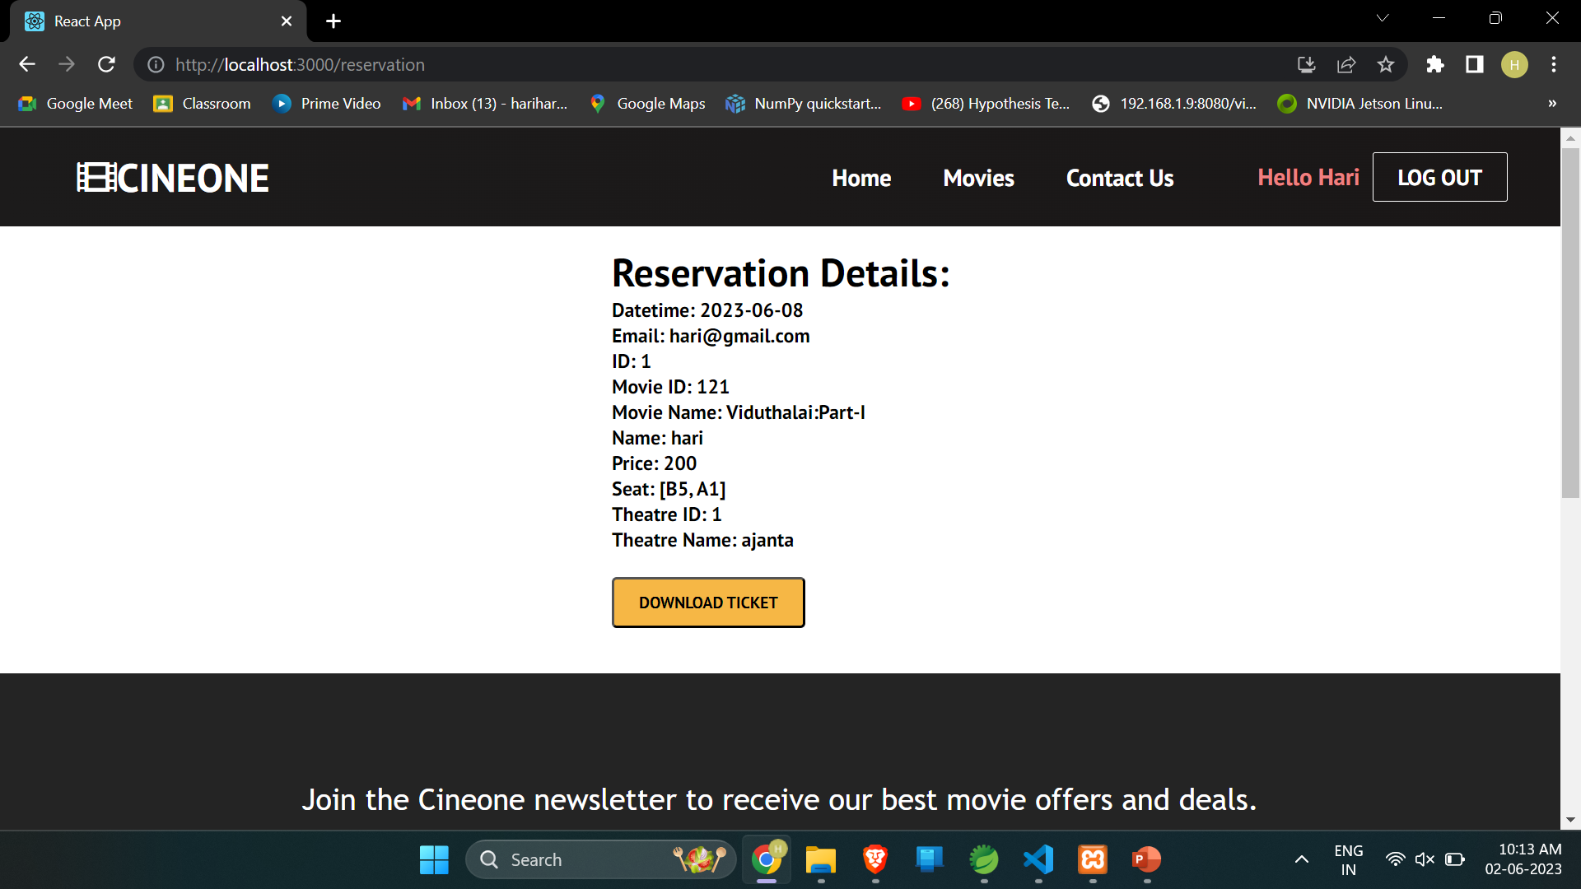
Website Pictures (Reservation Details)

Slide 23
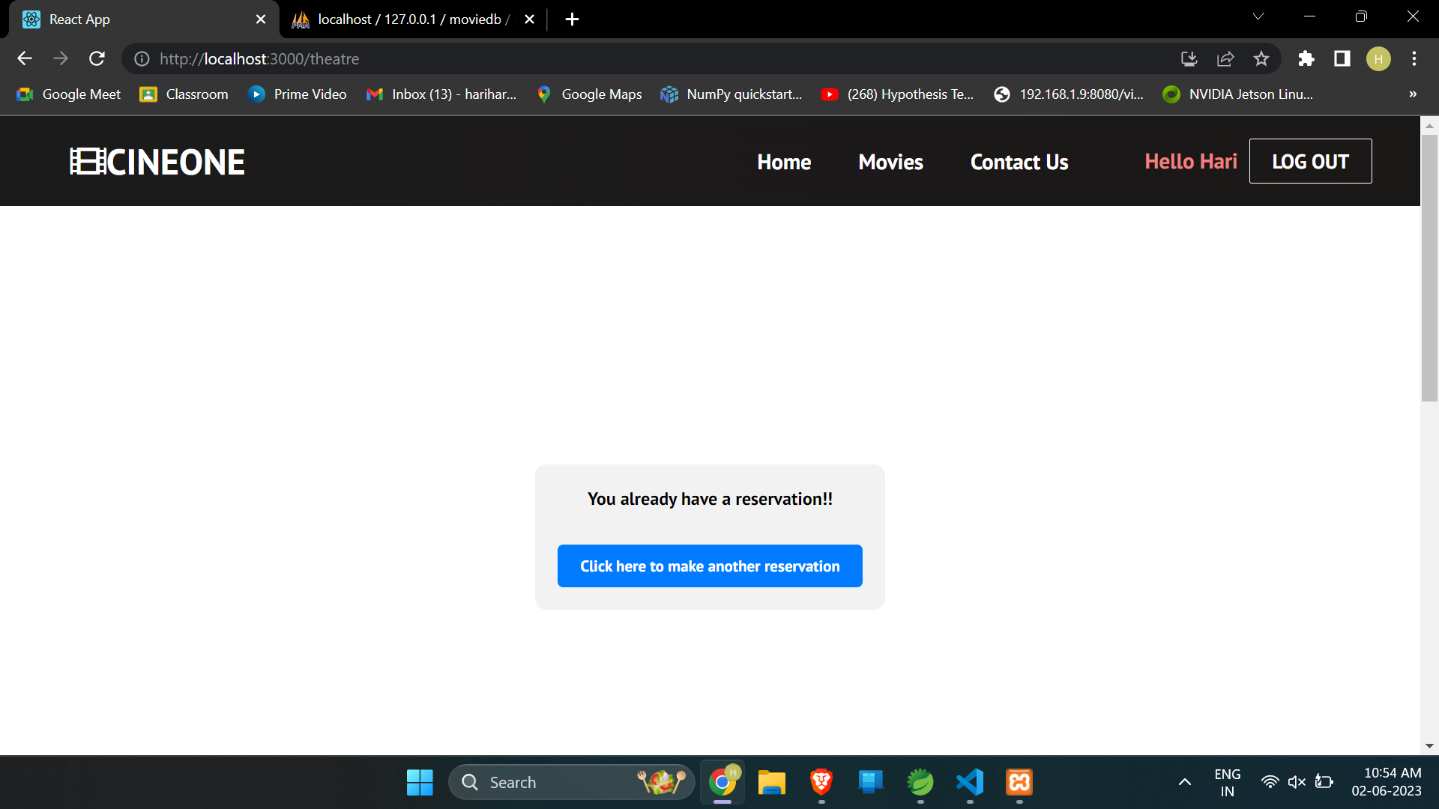
Website Pictures (User needs to sign in separately to book another ticket)

Slide 24
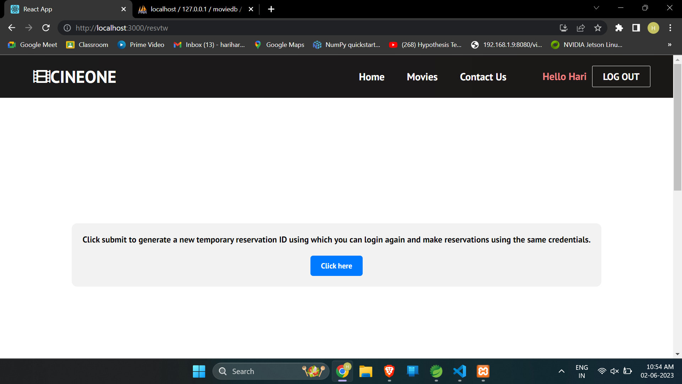
Website Pictures (User needs to sign in separately to book another ticket)

Slide 25
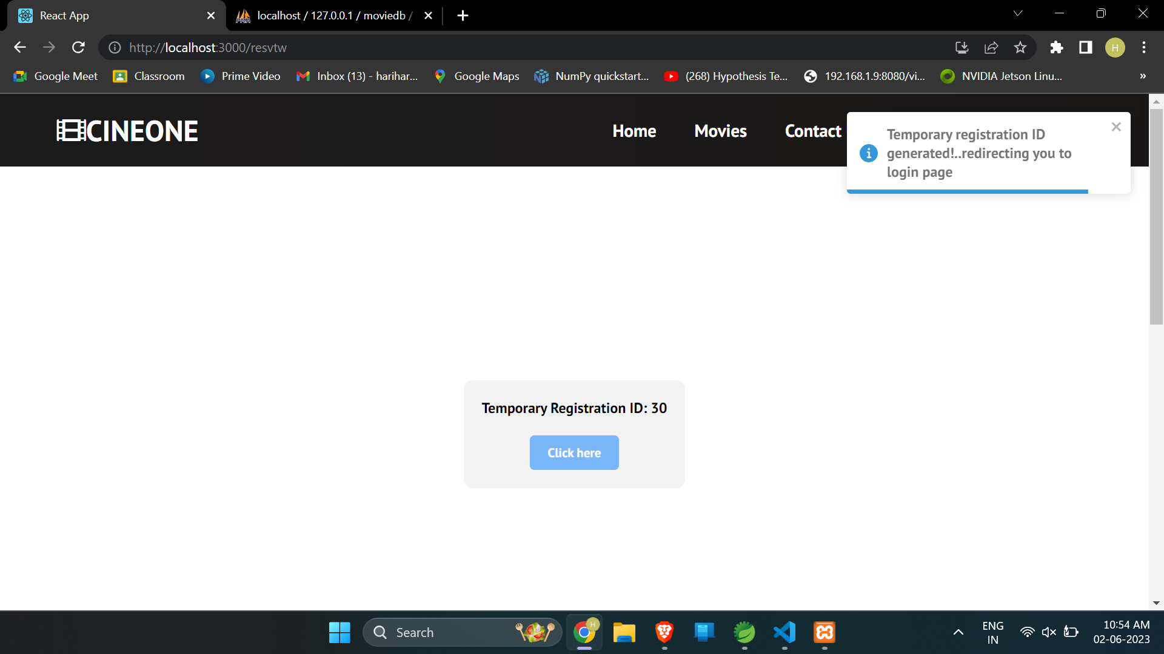
Website Pictures (User uses this ID to book another ticket)

Slide 26
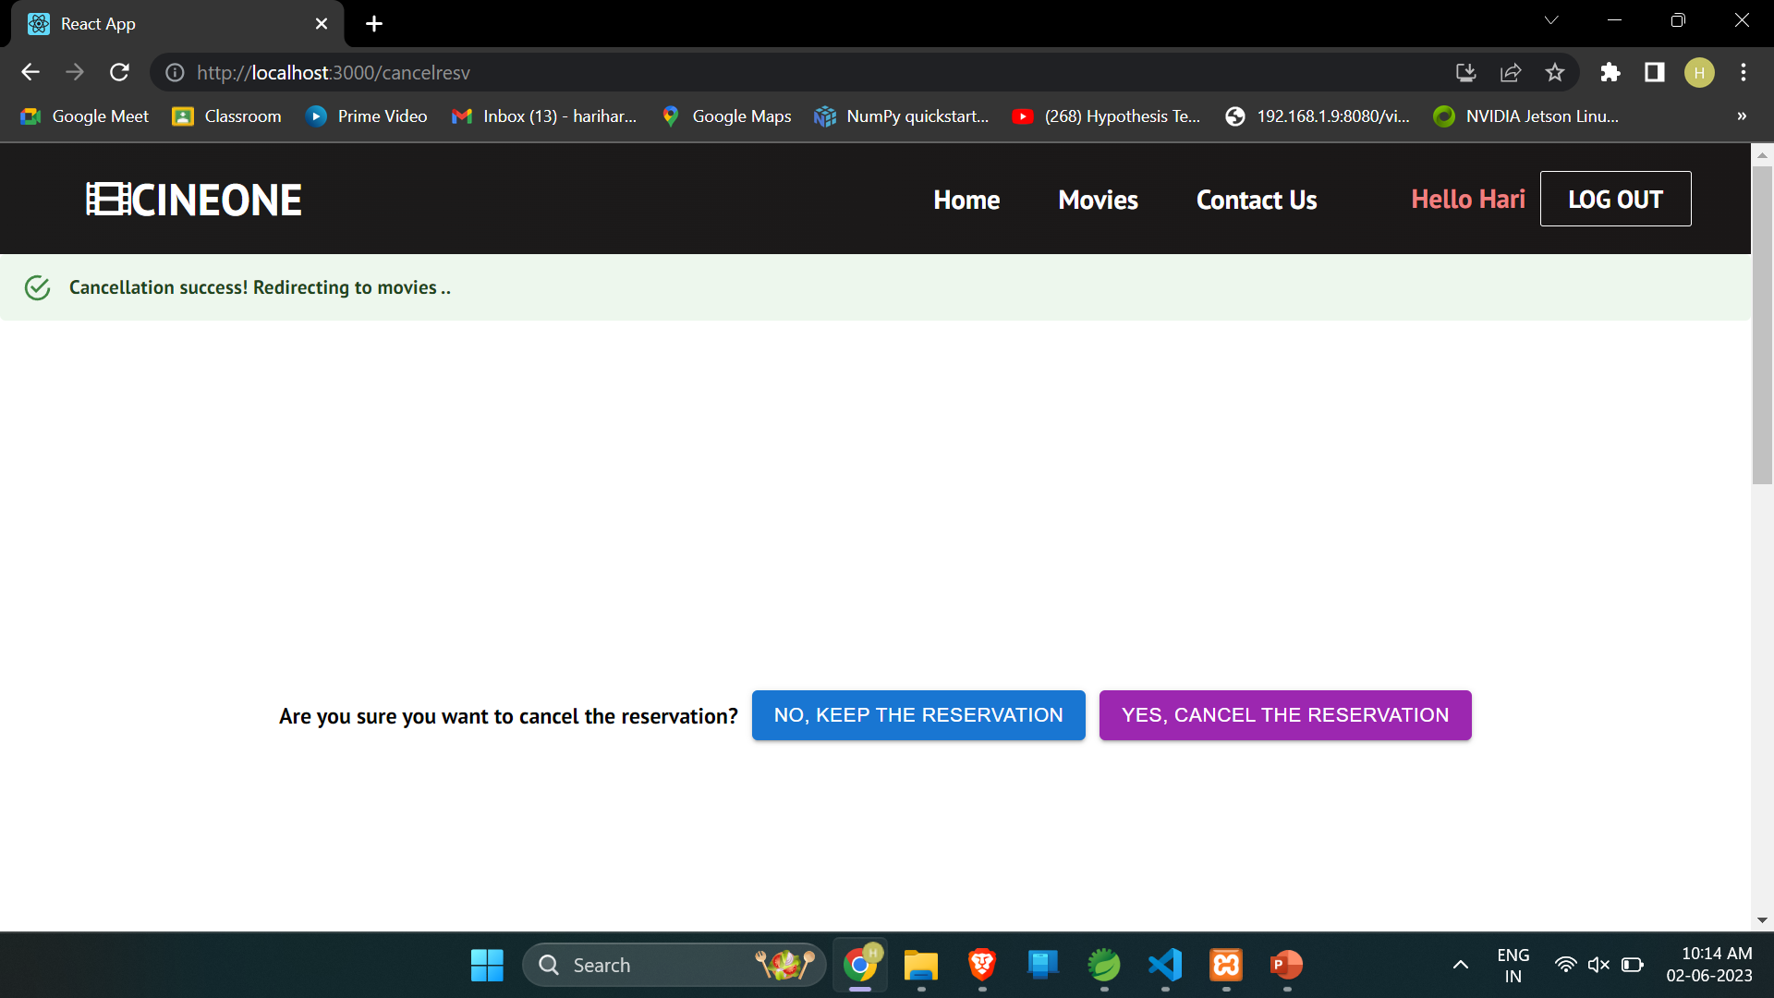
Website Pictures (Booking Cancellation)

Slide 27
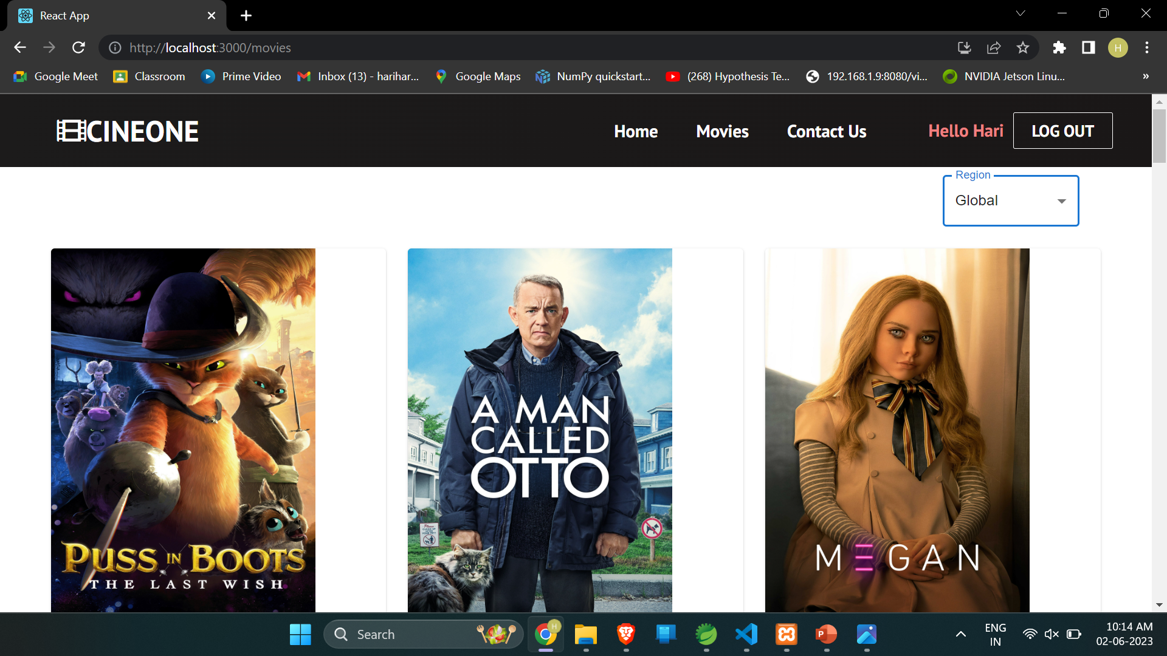
Website Pictures (Home page after cancellation)

